Slide 1
Greedy Method Unit-2, Module-2

Slide 2
Optimization Problems
An optimization problem is one in which you want to find, not just a solution, but the best solution
A problem that may have many feasible solutions.
Each solution has a value
In maximization problem , we wish to find a solution to maximize the value
In the minimization problem, we wish to find a solution to minimize the value

Slide 3
Technique to Solve a Optimization Problem
Greedy Method
Dynamic Programming
Branch and Bound

Slide 4
Greedy Method
Many optimization problems can be solved using a greedy approach.
The basic principle is that local optimal decisions may be used to build an optimal solution.
But the greedy approach may not always lead to an optimal solution overall for all problems
The key is knowing which problems will work with this approach and which will not.

Slide 5
Greedy Method (Contd..)
Greedy algorithm obtains an optimal solution by making a sequence of decisions.
Decisions are made one by one in some order.
This method is used to solve optimization problems
This type of problems involves in minimum or maximum result
Each decision is made using a greedy- choice property or greedy criterion.
A decision, once made, is (usually) not changed later.
It gives an optimal solution when applied to problems with the greedy-choice property.
A feasible solution is a solution that satisfies the constraints.
An optimal solution is a feasible solution that optimizes the objective function.

Slide 6
Everyday examples
A greedy algorithm always makes the choice that looks best at the moment
My everyday examples:
Playing cards
Invest on stocks
Choose a university
The hope: a locally optimal choice will lead to a globally optimal solution
For some problems, it works
Greedy algorithms tend to be easier to code

Slide 7
Greedy Technique
Greedy algorithms are simple and straightforward.
They are shortsighted in their approach in the sense that they take decisions on the basis of information at hand without worrying about the effect these decisions may have in the future.
They are easy to invent, easy to implement and most of the time quite efficient.
Many problems cannot be solved correctly by greedy approach.
Greedy algorithms are used to solve optimization problems

Slide 8
Greedy Approach
Greedy Algorithm works by making the decision that seems most promising at any moment; it never reconsiders this decision, whatever situation may arise later.

Slide 9
Components of Greedy Method
The greedy algorithm consists of five (5) functions
A Candidate Set: Solution is created from this set.
A Selection Set: A Function used to choose the best candidate to be added to the solution.
A Feasibility Set: A function that checks the feasibility of a set
An Objective Function: A Function which is used to assign value to a solution or partial solution.
A Solution Function: A Function which is used to indicate whether a complete solution has been reached

Slide 10
Greedy method control abstraction/ general method
Algorithm Greedy(a, n)
// a[1:n] contains the n inputs
{
for i=1 to n do //Initialize solution
{
x:=Select(a);
if Feasible(solution, x) then
solution=Union(solution, x)
}
return solution;
}

Slide 11
Structure of Greedy Algorithm
Initially the set of chosen items is empty i.e., solution set.
At each step
item will be added in a solution set by using selection function.
IF the set would no longer be feasible
reject items under consideration (and is never consider again).
ELSE IF set is still feasible THEN
add the current item.

Slide 12
Characteristics of Greedy Method
To construct the solution in an optimal way Algorithm maintains two sets. They are:
Chosen items set
Rejected items set
Greedy algorithm makes good local choices. They are:
An optimal solution
A Feasible solution

Slide 13
Applications of Greedy Method
Fractional knapsack algorithm
Optimal Storage on tapes
Job sequencing with deadline
Single source shortest path
Dijkstra's SSSP algorithm
Activity Selection Problem
Minimum Cost Spanning Tree

Slide 14
Example: Counting money
Suppose you want to count out a certain amount of money, using the fewest possible bills and coins
A greedy algorithm would do this would be: At each step, take the largest possible bill or coin that does not overshoot
Example: To make $6.39, you can choose:
a $5 bill
a $1 bill, to make $6
a 25¢ coin, to make $6.25
A 10¢ coin, to make $6.35
four 1¢ coins, to make $6.39
For US money, the greedy algorithm always gives the optimum solution

Slide 15
A simple example
Problem: Pick k numbers out of n numbers such that the sum of these k numbers is the largest
Algorithm:
for i=1 to k do
pick out the largest number and
delete this number from the input
end for
Suppose that a problem can be solved by a sequence of decisions.
The greedy method has that each decision is locally optimal.
These locally optimal solutions will finally add up to a globally optimal solution
Only a few optimization problems can be solved by the greedy method

Slide 16
Example 2
As an example, consider the problem of “Making Change”.
Coins available are:
dollars (100 cents)
quarters (25
dimes (10 cents)
nickels (5 cents)
pennies (1 cent)
Problem: Make a change of a given amount using the smallest possible number of coins.

Slide 17
Solution
Problem Make a change of a given amount using the smallest possible number of coins.
Informal Algorithm
Start with nothing.
at every stage without passing the given amount.
add the largest to the coins already chosen.

Slide 18
Solution : Algorithm
MAKE CHANGE (n)
C ←{100, 25, 10, 5, 1}//Constant
Sol ←{}; // set that will hold the solution
Sum ← 0 sum of item in solution set
WHILE sum not = n
x = largest item in set C such that sum + x ≤ n
IF no such item, THEN
RETURN “No Solution”
S ← S {value of x}
sum ← sum + x
RETURN S

Slide 19
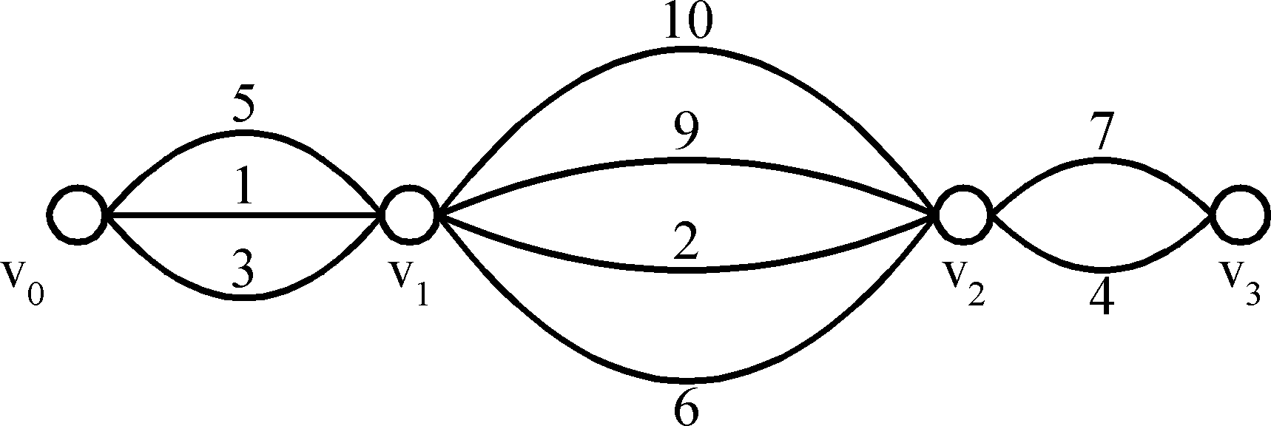
Example3: Shortest Path on a Special Graph
Problem : Find a shortest path from v₀ to v₃
The greedy method can solve this problem
The shortest path ?

Slide 20
Example3: Shortest Path on a Special Graph
Problem : Find a shortest path from v₀ to v₃
The greedy method can solve this problem
The shortest path 1+2+4=7

Slide 21
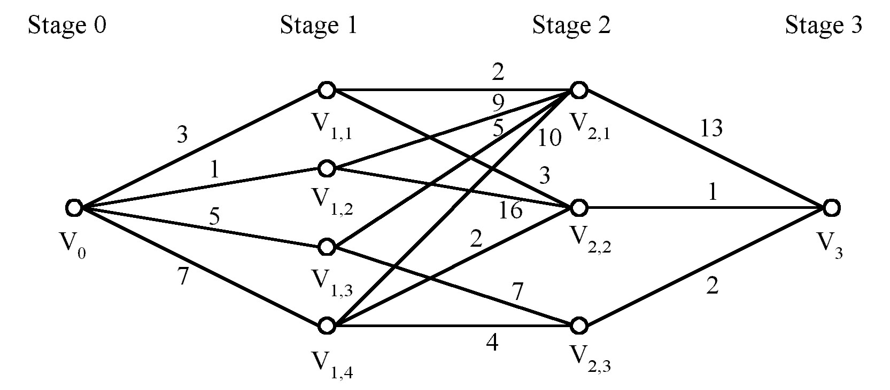
Shortest Paths on a Multi-stage Graph
Is the greedy solution optimal for below problem?
Problem
Find a shortest path from v0 to v3

Slide 22
Shortest Paths on a Multi-stage Graph
Is the greedy solution optimal for below problem?
Problem
Find a shortest path from v0 to v3

Slide 23
A failure of the greedy algorithm
In some (fictional) monetary system, “krons” come in 1 kron, 7 kron, and 10 kron coins
Using a greedy algorithm to count out 15 krons, you would get
A 10 kron piece
Five 1 kron pieces, for a total of 15 krons
This requires six coins
A better solution would be to use two 7 kron pieces and one 1 kron piece
This only requires three coins
The greedy algorithm results in a solution, but not in an optimal solution

Slide 24
Knapsack Problem
Statement: A thief robbing a store and can carry a maximal weight of w into their knapsack. There are n items and i^{th} item weigh w_{i} and is worth v_{i} dollars. What items should thief take?
There are two versions of problem

Slide 25
Fractional knapsack problem
The setup is same, but the thief can take fractions of items, meaning that the items can be broken into smaller pieces so that thief may decide to carry only a fraction of x_{i} of item i, where 0 ≤ x_{i} ≤ 1.Exhibit greedy choice
Greedy algorithm exists.
Exhibit optimal substructure property?????

Slide 26
0/1 knapsack problem
The setup is the same, but the items may not be broken into smaller pieces, so thief may decide either to take an item or to leave it (binary choice) but may not take a fraction of an item. Exhibit No greedy choice property.
No greedy algorithm exists.
Exhibit optimal substructure property.
Only dynamic programming algorithm exists.

Slide 27
The Fractional Knapsack Problem
There are n items in a store. For i =1,2, . . . , n , item i has weight w_{i} >0 and worth p_{i} > 0 . Thief can carry a maximum weight of M pounds in a knapsack.
In this version of a problem the items can be broken into smaller piece, so the thief may decide to carry only a fraction x_{i} of object i , where 0 ≤ x_{i} ≤1 . Item i contributes x_{i}w_{i} to the total weight in the knapsack, and x_{i}p_{i} to the value of the load.
In Symbol, the fraction knapsack problem can be stated as follows. Maximize ^{n}S_{i=1} x_{i}p_{i} subject to constraint ^{n}S_{i=1} x_{i}w_{i} ≤ M
It is clear that an optimal solution must fill the knapsack exactly, for otherwise we could add a fraction of one of the remaining objects and increase the value of the load. Thus, in an optimal solution ^{n}S_{i=1} x_{i}w_{i} = M

Slide 28
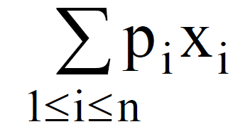
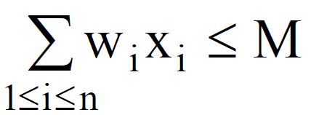

The Fractional Knapsack Problem (Contd..)
n objects, each with a weight w_{i} > 0
a profit p_{i} > 0
capacity of knapsack: M
Maximize
Subject to

Slide 29
Algorithm
Algorithm Greedy-fractional-knapsack (w, p, M)
for i =1 to n do
x[i] = 0
v[i] = p[i] / w[i]
weight = 0
while (weight < M) do
i = best remaining item with highest value of v[i]
if (weight + w[i] ≤ M) then
x[i] = 1
weight = weight + w[i]
else
x[i] = (M - weight) / w[i]
weight = M
return x

Slide 30
Algorithm2
Algorithm fractionalknapsack(item A[ ], Total_Capacity, n) {
sort(A,A + n,cmp);
cur_weight = 0;
final_val = 0.0;
for i=0 to n do {
if(cur_weight + arr[i].weight <= Total_Capacity){
Cur_weight += A[i].weight;
Final_val += A[i].value;
}
else {
remain = Total_capacity - cur_weight;
Final_val += A[i].value * (remain / A[i].weight);
}
}
return final_val;
}

Slide 31
Knapsack Problem
Objects (O) | 1 | 2 | 3 | 4 | 5 | 6 | 7
Profits (P) | 10 | 5 | 15 | 7 | 6 | 18 | 3
Weight (W) | 2 | 3 | 5 | 7 | 1 | 4 | 1
15Kg

Slide 32
Knapsack Problem
Objects (O) | 1 | 2 | 3 | 4 | 5 | 6 | 7
Profits (P) | 10 | 5 | 15 | 7 | 6 | 18 | 3
Weight (W) | 2 | 3 | 5 | 7 | 1 | 4 | 1
X | X1 | X2 | X3 | X4 | X5 | X6 | X7
15Kg

Slide 33
Knapsack Problem
Objects (O) | 1 | 2 | 3 | 4 | 5 | 6 | 7
Profits (P) | 10 | 5 | 15 | 7 | 6 | 18 | 3
Weight (W) | 2 | 3 | 5 | 7 | 1 | 4 | 1
P/W | 5 | 1.3 | 3 | 1 | 6 | 4.5 | 3
X | X1 | X2 | X3 | X4 | X5 | X6 | X7
15Kg
15 - 1 = 14

Slide 34
Knapsack Problem
Objects (O) | 1 | 2 | 3 | 4 | 5 | 6 | 7
Profits (P) | 10 | 5 | 15 | 7 | 6 | 18 | 3
Weight (W) | 2 | 3 | 5 | 7 | 1 | 4 | 1
P/W | 5 | 1.3 | 3 | 1 | 6 | 4.5 | 3
X | X1 | X2 | X3 | X4 | X5 | X6 | X7
15Kg
15 - 1 = 14
14 - 2 = 12

Slide 35
Knapsack Problem
Objects (O) | 1 | 2 | 3 | 4 | 5 | 6 | 7
Profits (P) | 10 | 5 | 15 | 7 | 6 | 18 | 3
Weight (W) | 2 | 3 | 5 | 7 | 1 | 4 | 1
P/W | 5 | 1.3 | 3 | 1 | 6 | 4.5 | 3
X | X1 | X2 | X3 | X4 | X5 | X6 | X7
15Kg
15 - 1 = 14
14 - 2 = 12
12 - 4 = 8

Slide 36
Knapsack Problem
Objects (O) | 1 | 2 | 3 | 4 | 5 | 6 | 7
Profits (P) | 10 | 5 | 15 | 7 | 6 | 18 | 3
Weight (W) | 2 | 3 | 5 | 7 | 1 | 4 | 1
P/W | 5 | 1.3 | 3 | 1 | 6 | 4.5 | 3
X | X1 | X2 | X3 | X4 | X5 | X6 | X7
15Kg
15 - 1 = 14
14 - 2 = 12
12 - 4 = 8
8 – 5 = 3

Slide 37
Knapsack Problem
Objects (O) | 1 | 2 | 3 | 4 | 5 | 6 | 7
Profits (P) | 10 | 5 | 15 | 7 | 6 | 18 | 3
Weight (W) | 2 | 3 | 5 | 7 | 1 | 4 | 1
P/W | 5 | 1.3 | 3 | 1 | 6 | 4.5 | 3
X | X1 | X2 | X3 | X4 | X5 | X6 | X7
15Kg
15 - 1 = 14
14 - 2 = 12
12 - 4 = 8
8 – 5 = 3
3 – 1 = 2

Slide 38
Knapsack Problem
Objects (O) | 1 | 2 | 3 | 4 | 5 | 6 | 7
Profits (P) | 10 | 5 | 15 | 7 | 6 | 18 | 3
Weight (W) | 2 | 3 | 5 | 7 | 1 | 4 | 1
P/W | 5 | 1.3 | 3 | 1 | 6 | 4.5 | 3
2/3
X | X1 | X2 | X3 | X4 | X5 | X6 | X7
15Kg
15 - 1 = 14
14 - 2 = 12
12 - 4 = 8
8 – 5 = 3
3 – 1 = 2
2 – 2 = 0

Slide 39
Knapsack Problem
Objects (O) | 1 | 2 | 3 | 4 | 5 | 6 | 7
Profits (P) | 10 | 5 | 15 | 7 | 6 | 18 | 3
Weight (W) | 2 | 3 | 5 | 7 | 1 | 4 | 1
P/W | 5 | 1.3 | 3 | 1 | 6 | 4.5 | 3
2/3
0
X | X1 | X2 | X3 | X4 | X5 | X6 | X7
15Kg
15 - 1 = 14
14 - 2 = 12
12 - 4 = 8
8 – 5 = 3
3 – 1 = 2
2 – 2 = 0

Slide 40
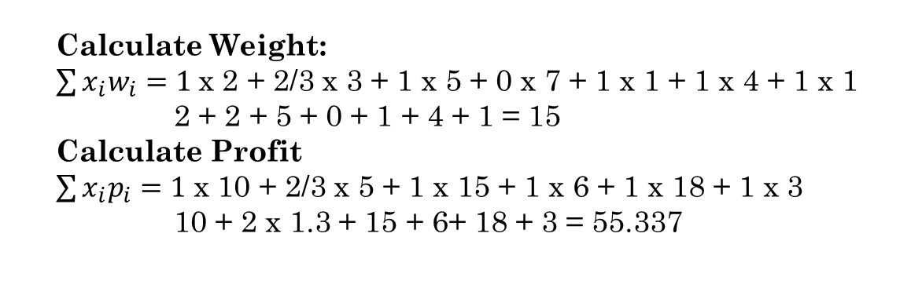
Knapsack Problem
Objects (O) | 1 | 2 | 3 | 4 | 5 | 6 | 7
Profits (P) | 10 | 5 | 15 | 7 | 6 | 18 | 3
Weight (W) | 2 | 3 | 5 | 7 | 1 | 4 | 1
P/W | 5 | 1.3 | 3 | 1 | 6 | 4.5 | 3
2/3
0
X | X1 | X2 | X3 | X4 | X5 | X6 | X7
Calculate Weight:
$\sum{x_{i}w_{i}=1 }$x 2 + 2/3 x 3 + 1 x 5 + 0 x 7 + 1 x 1 + 1 x 4 + 1 x 1
2 + 2 + 5 + 0 + 1 + 4 + 1 = 15
Calculate Profit
$\sum{x_{i}p_{i}=1 }$x 10 + 2/3 x 5 + 1 x 15 + 1 x 6 + 1 x 18 + 1 x 3
10 + 2 x 1.3 + 15 + 6+ 18 + 3 = 55.337

Slide 41
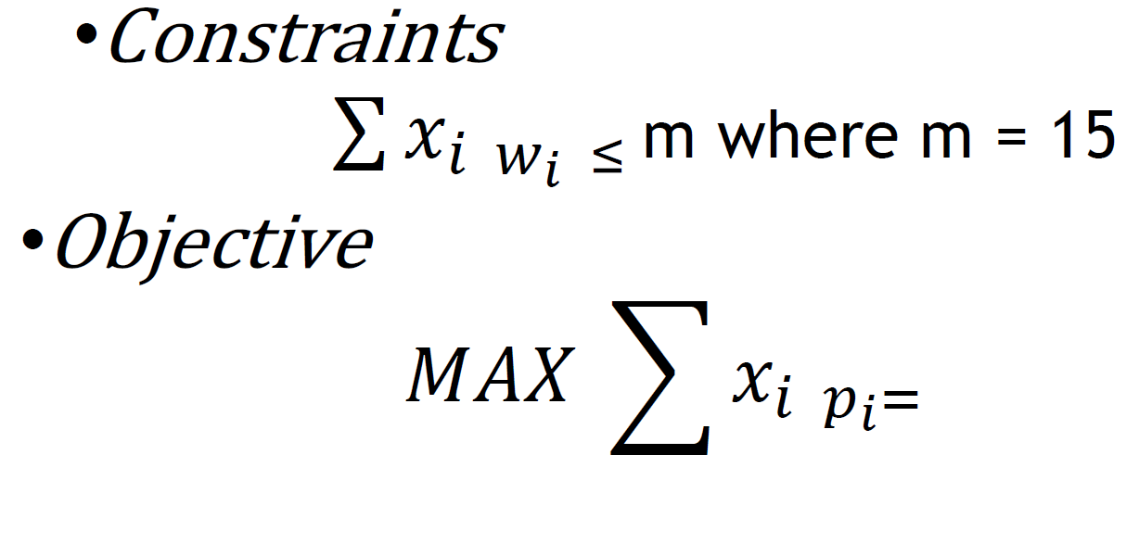
Conclusion

Slide 42
Analysis
If the items are already sorted into decreasing order of v_{i}/w_{i} then the while loop takes a time in O(n)
Therefore, the total time including the sort is in O(n log n)
If we keep the items in heap with largest v_{i}/w_{i} at the root. Then
creating the heap takes O(n) time
while loop now takes O(log n) time (since heap property must be restored after the removal of root)
Although this data structure does not alter the worst case, it may be faster if only a small number of items are need to fill the knapsack.

Slide 43
0/1 Knapsack Problem
An item is either included or not included into the knapsack.
Formally the problem can be stated as
maximize ∑ p_{i}x_{i}
1 ≤ i ≤ n subjected to ∑ w_{i}x_{i} ≤ M
1 ≤ i ≤ n
and x_{i}=0 or 1, 1 ≤ i ≤ n

Slide 44
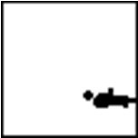





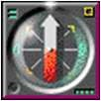















0/1 Knapsack Problem
Which items should be chosen to maximize the amount of money while still keeping the overall weight under m kg ?
m

Slide 45
0/1 Knapsack Problem
The greedy method works for fractional knapsack problem, but it does not for 0/1 knapsack problem.
20
30
$80
30
$120
item3
item2
20
item1
$100
20
$100
30
20
$100
20
10
$60
10
$60
10
$60
$100
$120
Knapsack Capacity 50 gms
=$160
=$220
=$240
(a)
(b)
(c)

Slide 46
Contd..
There are 3 items, the knapsack can hold 50 gms.
The value per gram of item 1 is 6, which is greater than the value per gram of either item2 or item3.
The greedy approach ( Decreasing order of profit’s/weight’s), does not give an optimal solution.
As we can see from the above fig., the optimal solution takes item2 and item3.
For the fractional problem, the greedy approach (Decreasing order of profit’s/weight’s) gives an optimal solution as shown in fig c.

Slide 47
Huffman Coding
Huffman Coding is a greedy technique to obtain an optimal solution to a problem.
The Huffman coding is generally used for lossless data compression mechanisms.
Sometimes, it is also called data compression encoding.
It makes sure that there is no ambiguity while decoding the output bitstream.
Greedy algorithms use a heuristic approach to make an optimal choice at each stage while problem-solving to find a globally optimized solution.

Slide 48
Cont..
Huffman Coding is used for both encoding and decoding.
It uses a greedy approach to solve problems.
The greedy approach allows us to solve a problem and find an optimal solution using the optimal substructure.
An optimal substructure to a problem is achieved if an optimal solution can be created from the optimal solutions of its subproblems.
The Huffman coding uses a prefix rule that avoids ambiguity while decoding. The two steps involved in Huffman coding are:
Construct a Huffman tree from the input string or text or characters.
Assigning a Huffman code to each character by traversing the tree.

Slide 49
Huffman Coding Algorithm
The Huffman coding algorithm, follows the greedy design approach to arrive at an optimal solution.
It uses a Huffman tree to encode and decode the data. A Huffman tree is created using the following steps:
Create a leaf node for each character of the text.
Arrange all the nodes in the increasing order of their frequency.
Considering the first two nodes have the minimum frequency.
Create an internal node.
The frequency of this internal node is the sum of the frequency of the previous two nodes.
Make the first and second nodes the left and right children respectively of the newly created node.
Repeat steps 2 and 3 until all the nodes form a tree. The tree thus obtained is a Huffman tree.
After the Huffman tree is created, each character is assigned a unique code. For decoding, the same Huffman tree is traversed.

Slide 50
Applications of Huffman Coding
The applications of the Huffman coding mechanism are
It is applied where a series of frequently occurring characters are used.
Used for transmitting the data in the form of text or fax etc.
Used by conventional compression formats like GZIP, PKZIP, etc.
Multimedia formats like JPEG, PNG, and MP3 use Huffman encoding.

Slide 51
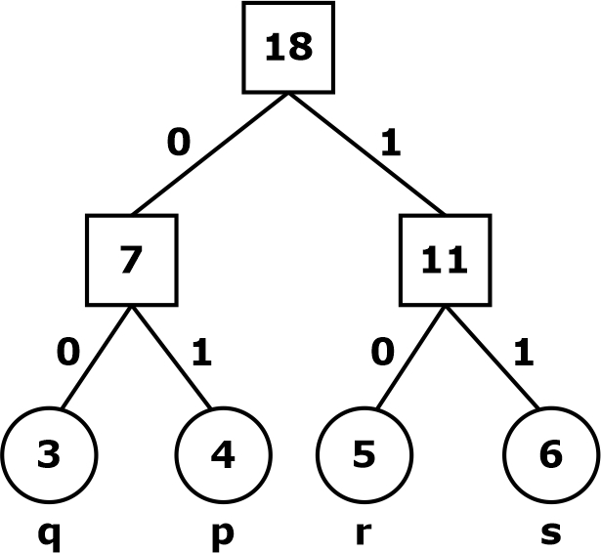
Huffman Coding Example
Question: Consider the following message: ppqqrrsspqrsprrsss?
Find the number of bits required for Huffman coding?
Solution:
Frequencies: p-4 , q-3 , r-5 , s-6
p – 01, q – 00, r – 10, s – 11
The total bits required for Huffman coding is
∑ (frequency) x (bits) = 4(2) + 3(2) + 5(2) + 6(2) = 36
Answer : 36.

Slide 52
Job Sequencing with Deadline
Problem Statement
In job sequencing problem, the objective is to find a sequence of jobs, which is completed within their deadlines and gives maximum profit.

Slide 53
Job sequencing with deadlines
We are given a set of n jobs.
Deadline d_{i}>=0 and a profit p_{i}>0 are associated with each job i.
For any job profit is earned if and only if the job is completed by its deadline.
To complete a job, a job has to be processed by a machine for one unit of time.
Only one machine is available for processing jobs.
A feasible solution of this problem is a subset of jobs such that each job in this subset can be completed by its deadline
The optimal solution is a feasible solution which will maximize the total profit.
The objective is to find an order of processing of jobs which will maximize the total profit.

Slide 54

Solution
Let us consider, a set of n given jobs which are associated with deadlines and profit is earned, if a job is completed by its deadline.
These jobs need to be ordered in such a way that there is maximum profit.
It may happen that all of the given jobs may not be completed within their deadlines.
Assume, deadline of i^{th} job J_{i} is d_{i} and the profit received from this job is p_{i}. Hence, the optimal solution of this algorithm is a feasible solution with maximum profit.
D(i)>0 for 1⩽i⩽n
Initially, these jobs are ordered according to profit, i.e.

Slide 55
Example Problem
Ex:-n=4,
( p₁,p₂,p₃,p₄ )=( 100,10,15,27 )
( d₁,d₂,d₃,d₄ )=( 2,1,2,1 )
The maximum deadline is 2 units, hence the feasible solution set must have <=2 jobs.

Slide 56
Example Problem
feasible solution
processing
sequence value
1.
2.
3.
4.
5.
6.
7.
8.
9.
(1,2)
(1,3)
(1,4)
(2,3)
(3,4)
(1)
(2)
(3)
(4)
2,1
1,3 or 3,1
4,1
2,3
4,3
1
2
3
4
110
115
127
25
42
100
10
15
27
Solution 3 is optimal.

Slide 57
Greedy Algorithm for job sequencing with deadlines
Sort p_{i} into decreasing order.
After sorting p₁ ≥ p₂ ≥ p₃ ≥ … ≥ p_{i}.
Add the next job i to the solution set if i can be completed by its deadline.
Stop if all jobs are examined. Otherwise, go to step 2.

Slide 58
Algorithm
Algorithm JS(d,j,n)
//d[i]≥1, 1 ≤ i ≤ n are the deadlines.
//The jobs are ordered such that p[1] ≥ p[2] …… ≥ p[n]
// j[i] is the i^{th} job in the optimal solution, 1≤ i ≤ k
{
d[0]=j[0]=0; // Initialize j[1]=1; // Include job 1 k=1;
for i=2 to n do
{
//Consider jobs in Descending order of p[i].
// Find position for i and check feasibility of
// insertion. r=k;
while( ( d[ j[r] ] > d[ i ] ) and ( d[ j[ r ] ] > r ) ) do
r = r-1;

Slide 59
Algorithm (Contd..)
if(d[ j[r] ] ≤ d[i] and d[ i ] > r )) then
{
// Insert i into j[ ].
for q=k to (r+1) step -1 do
j[q+1] = j[q];
j[r+1] :=i;
k:=k+1;
}
}
return k;
}
Time taken by this algorithm is o(n²)

Slide 60
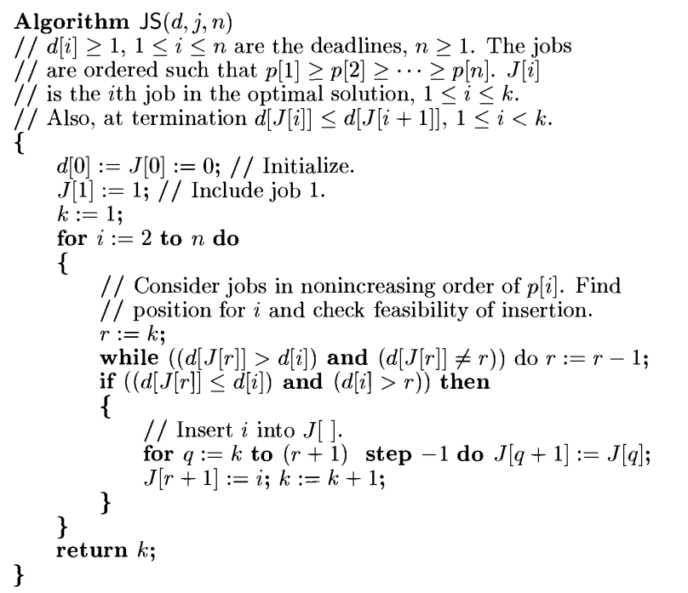
Text book Algorithm

Slide 61
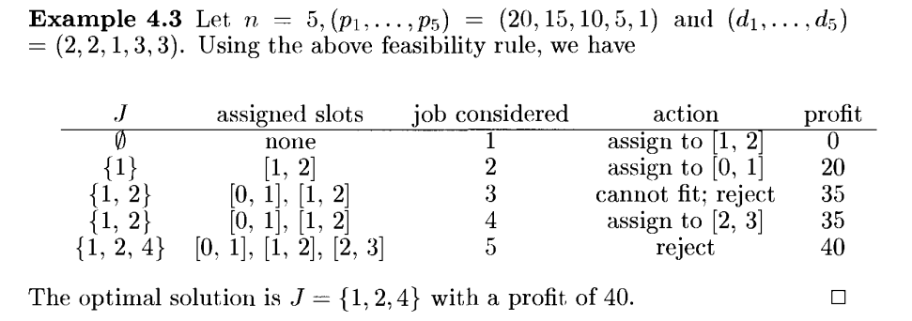
Example from Text book

Slide 62
Example
Let us consider a set of given jobs as shown in the following table. We have to find a sequence of jobs, which will be completed within their deadlines and will give maximum profit. Each job is associated with a deadline and profit.
Job | J₁ | J₂ | J₃ | J₄ | J₅
Deadline | 2 | 1 | 3 | 2 | 1
Profit | 60 | 100 | 20 | 40 | 20

Slide 63
Solution
To solve this problem, the given jobs are sorted according to their profit in a descending order. Hence, after sorting, the jobs are ordered as shown in the following table.
Job | J₂ | J₁ | J₄ | J₃ | J₅
Deadline | 1 | 2 | 2 | 3 | 1
Profit | 100 | 60 | 40 | 20 | 20

Slide 64
Cont..
From this set of jobs, first we select J₂, as it can be completed within its deadline and contributes maximum profit.
Next, J₁ is selected as it gives more profit compared to J₄.
In the next clock, J₄ cannot be selected as its deadline is over, hence J₃ is selected as it executes within its deadline.
The job J₅ is discarded as it cannot be executed within its deadline.
Thus, the solution is the sequence of jobs (J₂, J₁, J₃), which are being executed within their deadline and gives maximum profit.
Total profit of this sequence is 100 + 60 + 20 = 180.

